Slide 1
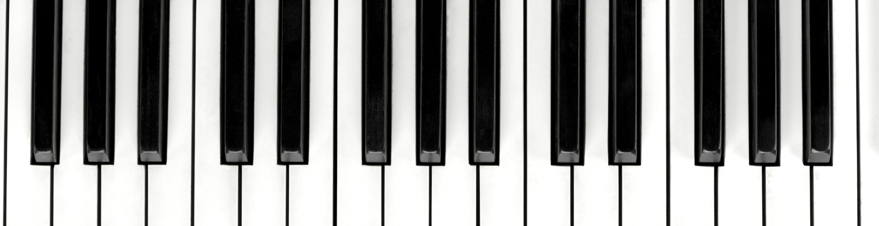
Piano Lesson 2
Free Knowledge Mission

Slide 2
What we’ll cover
PianoVideoLessons 3-20
Finger exercises
Landmark Notes
Steps in practicing reading music
Site read in music
Piano/Forte
Basic songs to get you started

Slide 3
Finger gyms
Important your finders are in the correct posture
Pull fingers on table
Push your fingers with your other hand
Push your fingers in you palm or playdoh
Practice playing even if you don’t have a piano

Slide 4
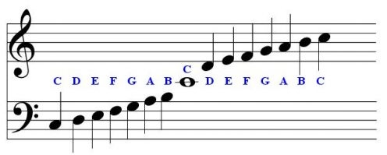
Landmark Notes
Treble Clef - G
Blass Clef – F – fourth line
Work your way out from these two
Use words to memorize notes
D – drip
A top bass clef
B top of bass clef

Slide 5
Practice
Practice each song with right, left, and both hands
Move your finger positions
Practice variety of rhythms(Whole, half, quarter notes)
Keep practicing without mistakes before moving on

Slide 6
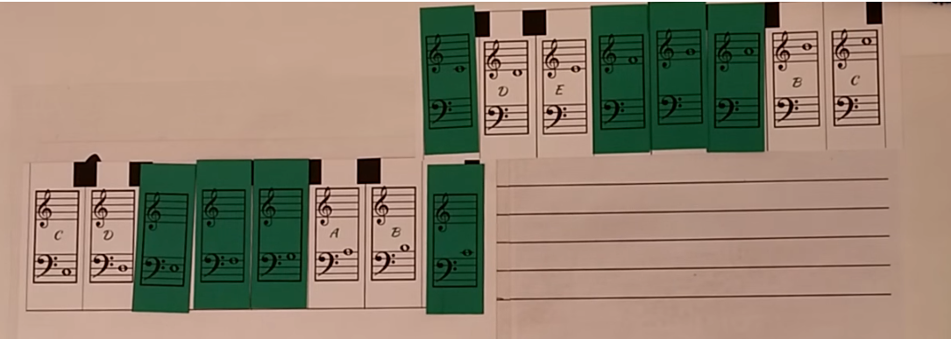
Flash Cards

Slide 7
Tips for Reading Sheet Music
While you play
Choose a tempo that is easy
Think ahead
Relax your body
Keep rounded fingers
No flying fingers
Count out loud
Sing the words
After you play
Circle any trouble spots
Practice those spots
Play again
Preparing to Play
Examine the music carefully
Name the notes
Clap & Tap and count out loud
Look for finger numbers
Practice by naming the notes
Prepare your hands before you plan
Look for note direction
Decide on your tempo

Slide 8
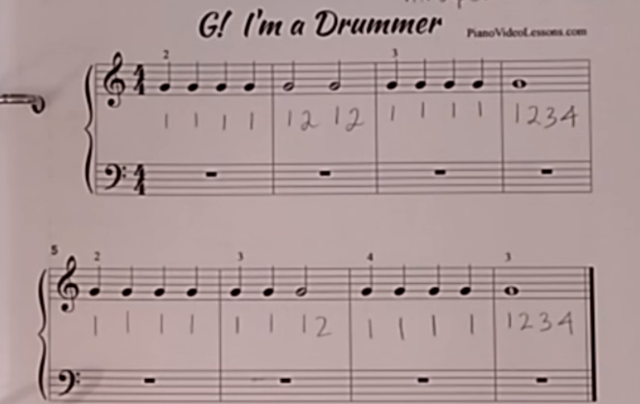
Site Reading
Playing only once without mistakes like reading a book.
More than once is practicing
Scan the whole sheet music
Look for patterns
Group the patterns

Slide 9

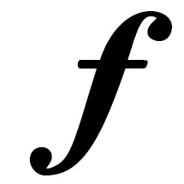
Piano/Forte
p on sheet music is soft or piano
f on sheet music is loud or forte

Slide 10
Practice Songs
PianoVideoLessons
Roughly one song per video lesson that progresses
Composed by instructor

Slide 11
Resources
PianoVideoLessons

